Slide 1

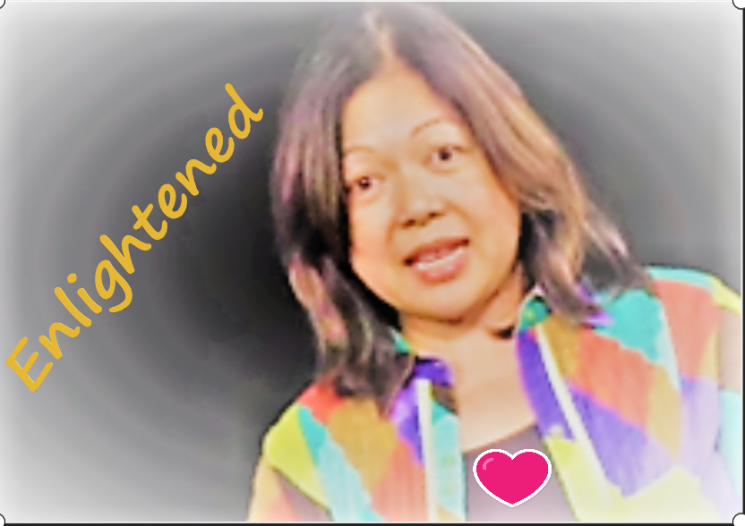
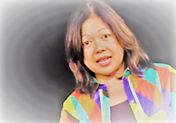
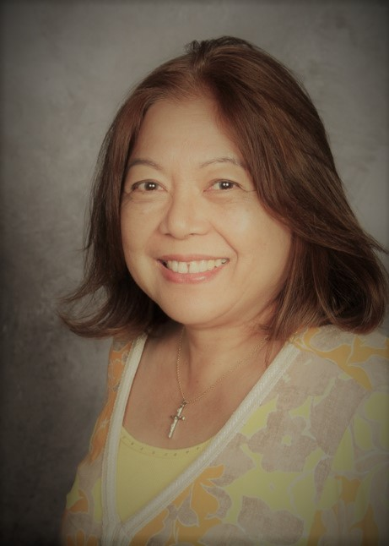
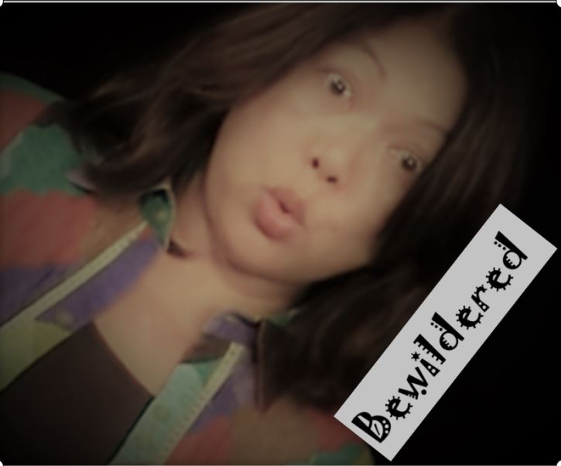
A slide show about me
Mrs. Guia Blaske

Slide 2
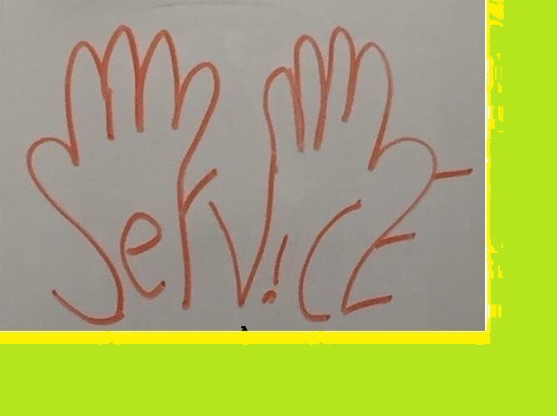

Years of teaching
Approaching 23 years of teaching:
      4 years in another district (Romoland and Nuview Bridge High School)
      19 years here at VISTA MURRIETA HIGH SCHOOL (VMHS); 12 years teaching Math; 7 years teaching Engineering

Slide 3
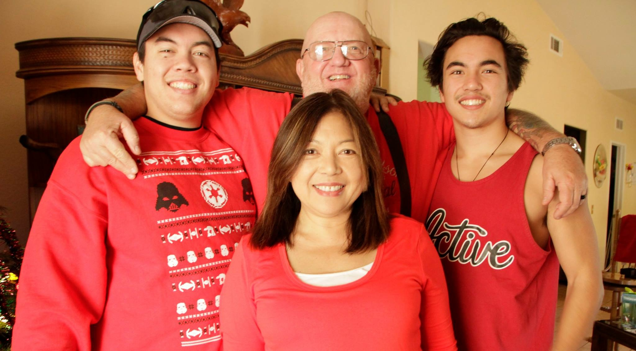
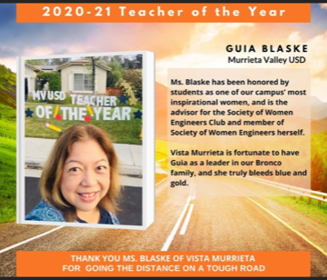
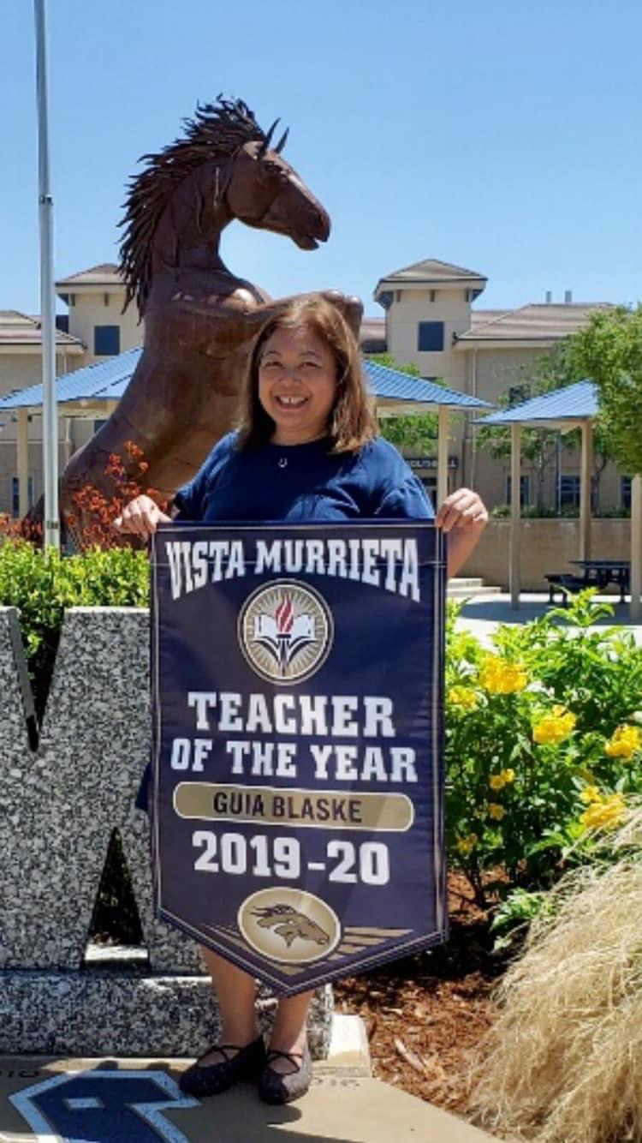
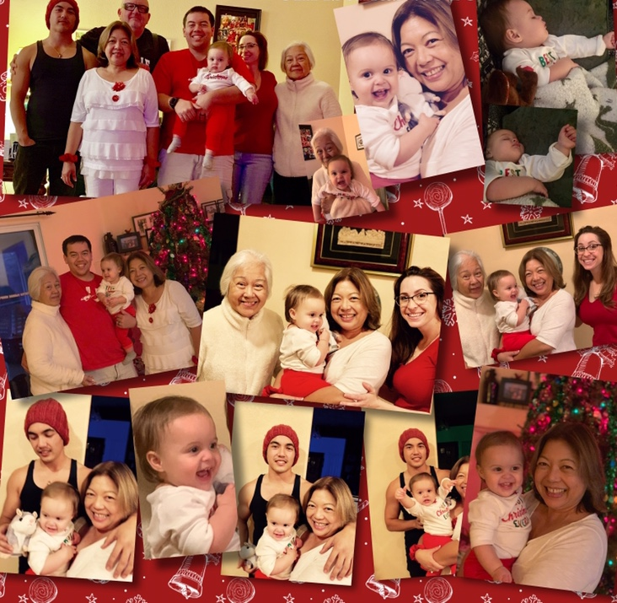
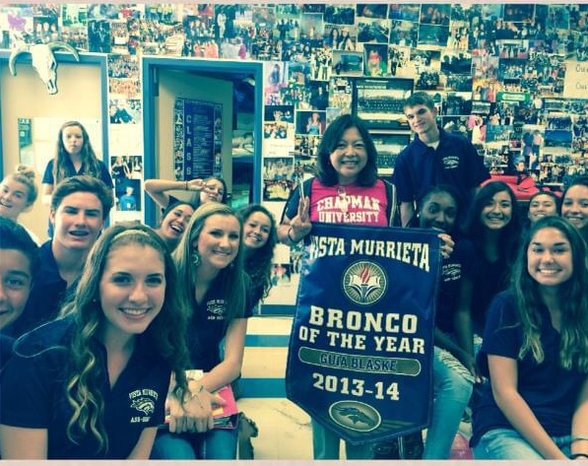
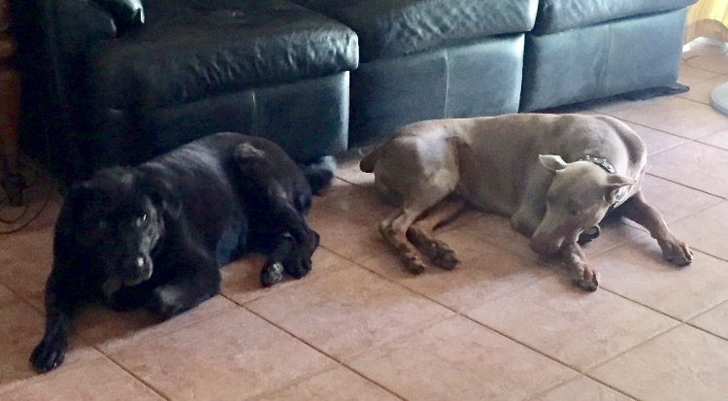

Slide 4
MATH AND ENGINEERING BACKGROUND
B.S. INDUSTRIAL ENGINEERING (University of the Philippines)
M.A. EDUCATIONAL ADMINISTRATION (Cal State University, San Bernardino)
TEACHING CREDENTIAL (Chapman University): FOUNDATIONAL MATHEMATICS, BUSINESS, INTRODUCTORY PHYSICAL SCIENCE (SUPPLEMENTAL) AND CTE-PRODUCT INNOVATION AND DESIGN
PROJECT LEAD THE WAY CERTIFICATION: Introduction to Engineering Design; Principles of Engineering; Engineering Design & Development

Slide 5

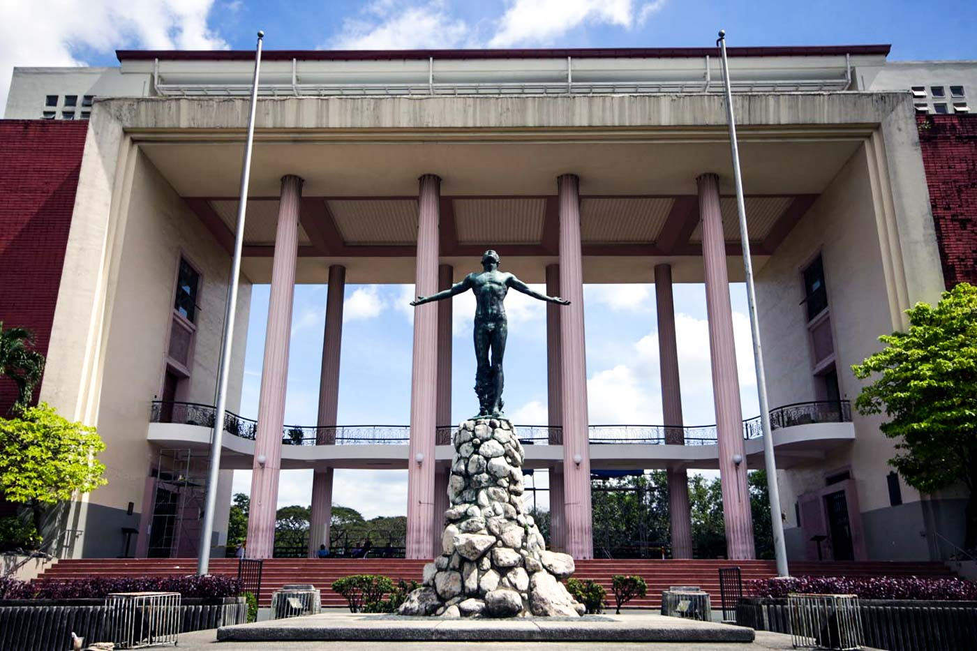
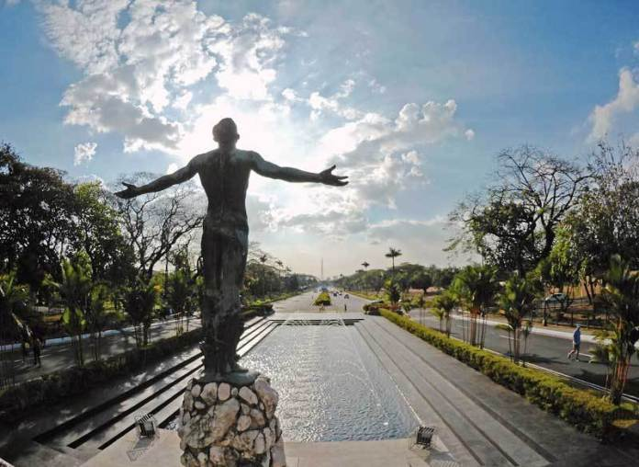
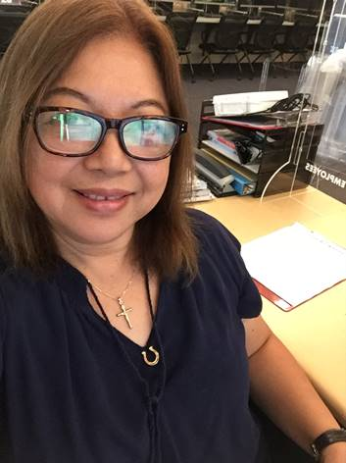



Slide 6
TECHNICAL JOB EXPERIENCE
SYSTEMS ANALYST
POLICY RESEARCHER ON MICROELECTRONICS
TECHNICAL ASSISTANT TO COMMISSIONER ON PRODUCTIVITY
PROJECT OFFICER, NATIONAL PRODUCTIVITY & TECHNOLOGY PROGRAM
PROJECT LEAD THE WAY (PLTW) COORDINATOR FOR VMHS
CERTIFIED TRAINING: PLTW-ENGINEERING (IED/POE/EDD)

Slide 7
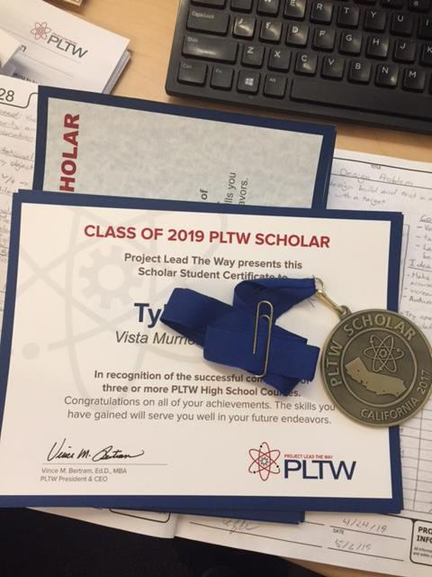
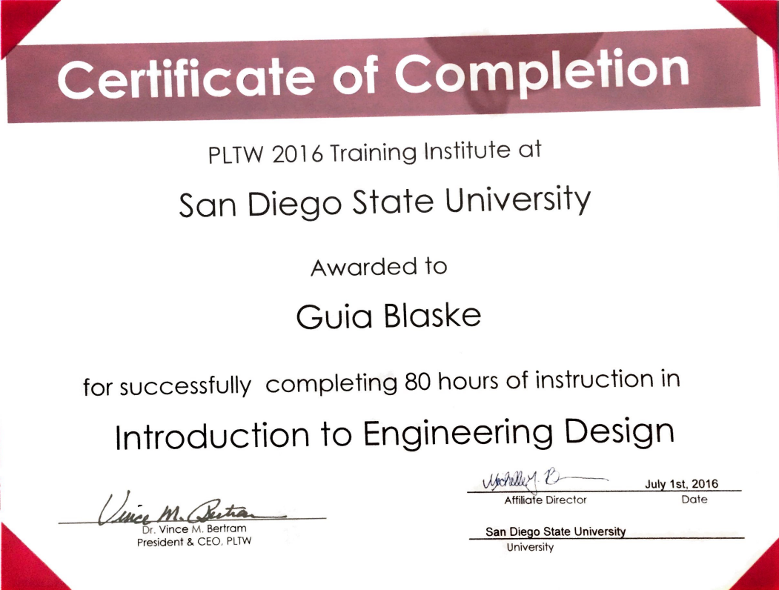
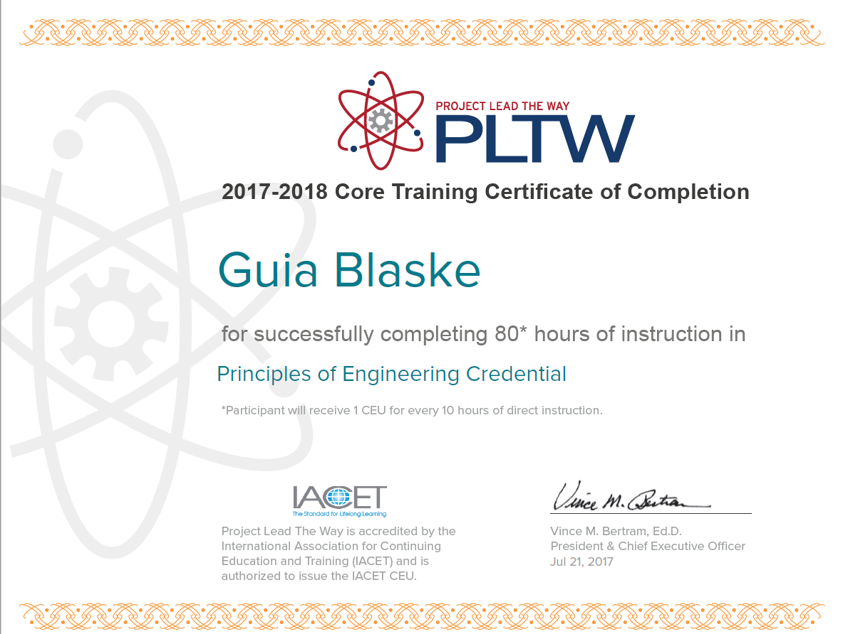
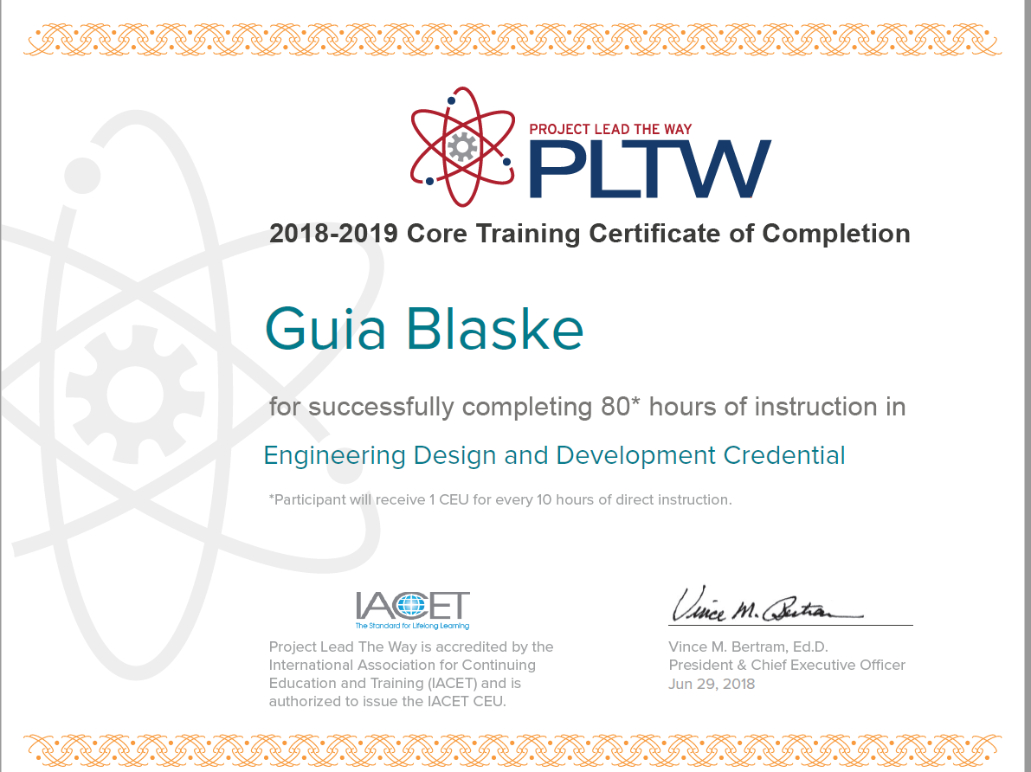
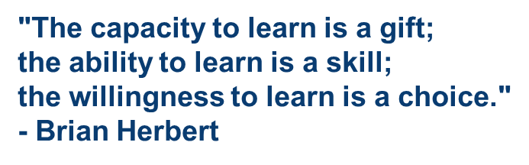

Slide 8
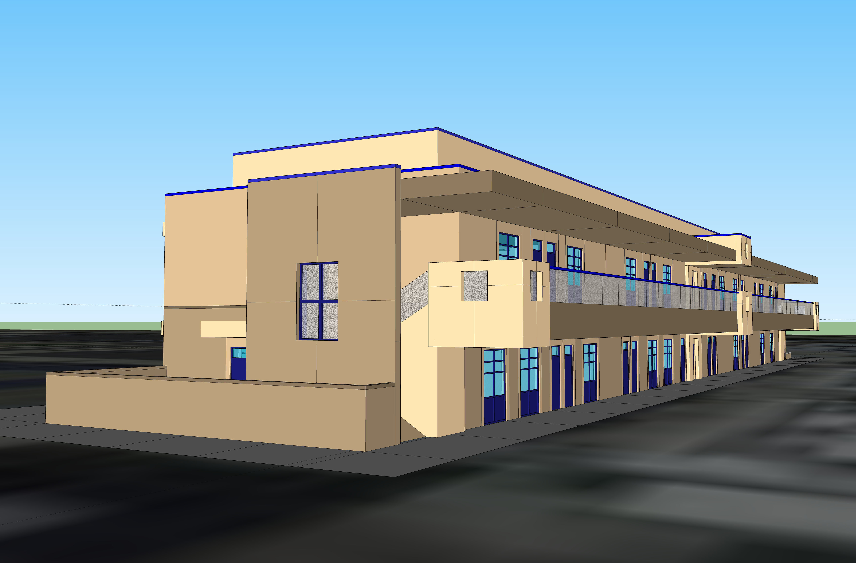
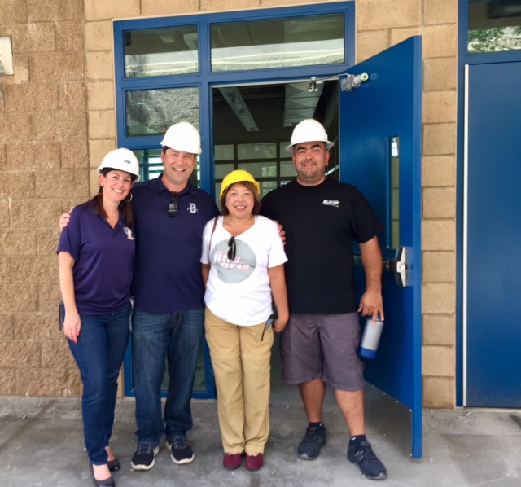
PROMOTING ENGINEERING AT VMHS
CTE-ENGINEERING: Initiated the engineering program and pathway at VMHS in 2015 and currently a 4-course pathway; By 2018, we were housed at a new C-building @C13 and C14
INDUSTRY LINKAGE: Field Trips/Internships/Work-Based Learning/Industry Partners/Resource Speakers/Career Readiness
CTE GRANTS: continuing to build capacity with the use of state grants for program implementation
INNOVATION CLUB: Robotics, Product Design/3D Printing, Women Engineers club

Slide 9
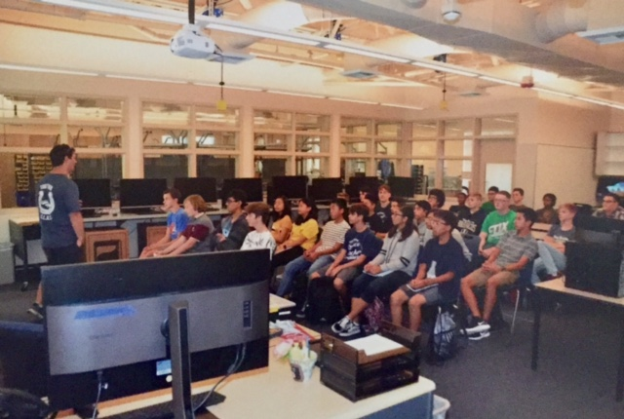
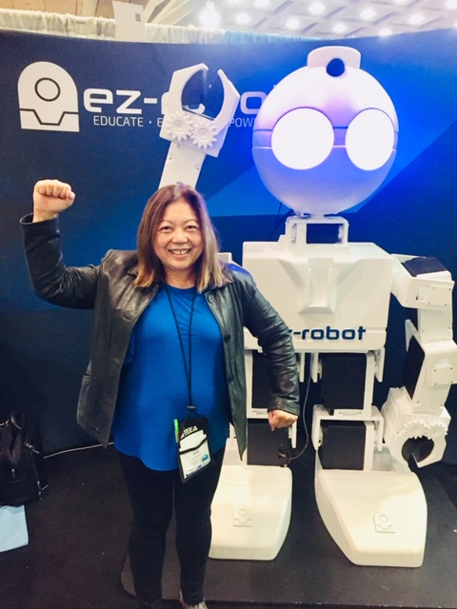
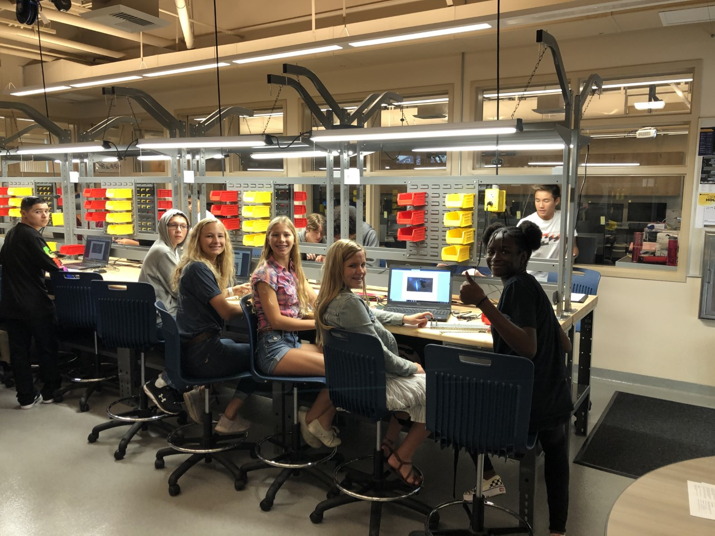
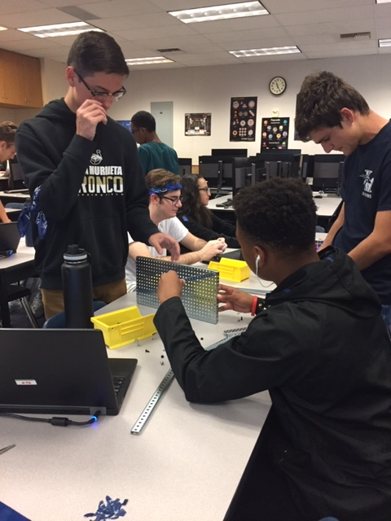
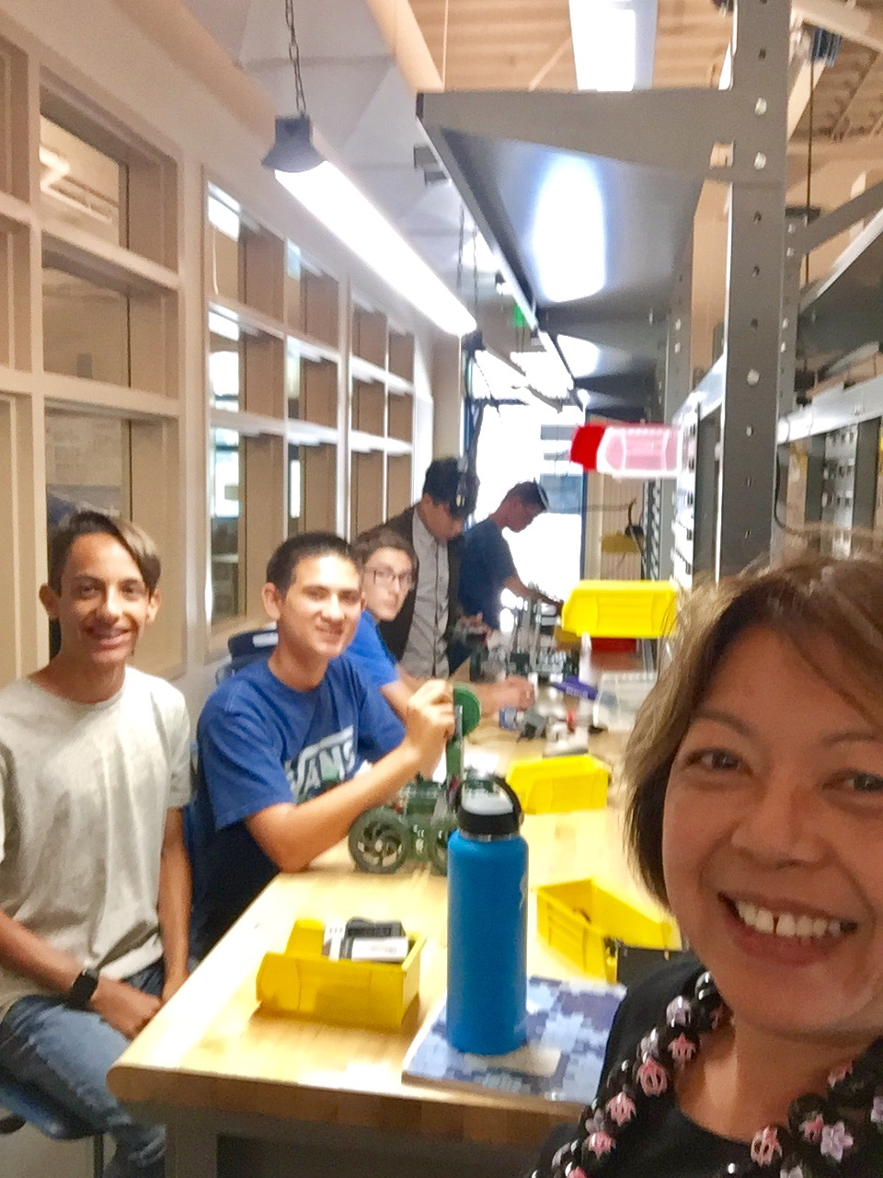
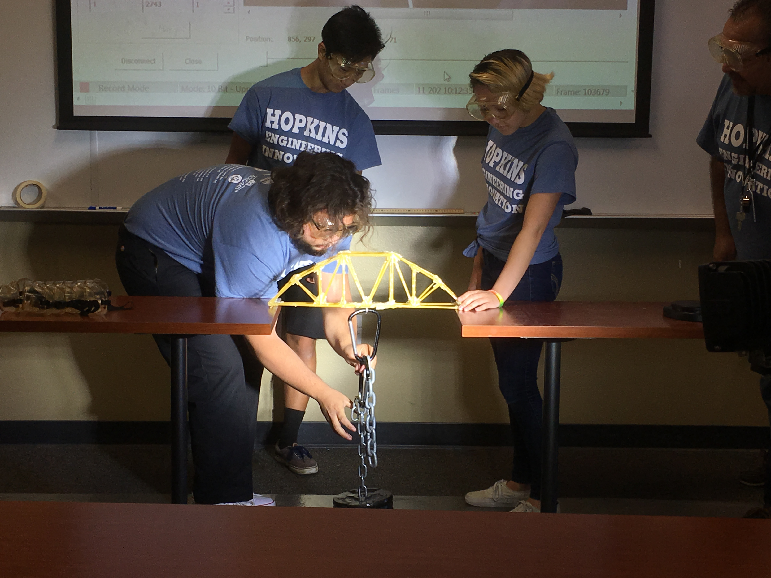
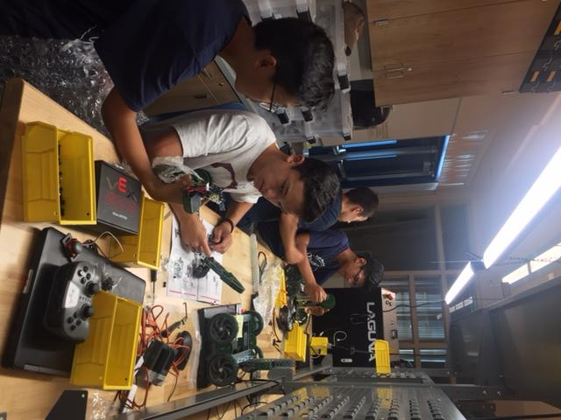
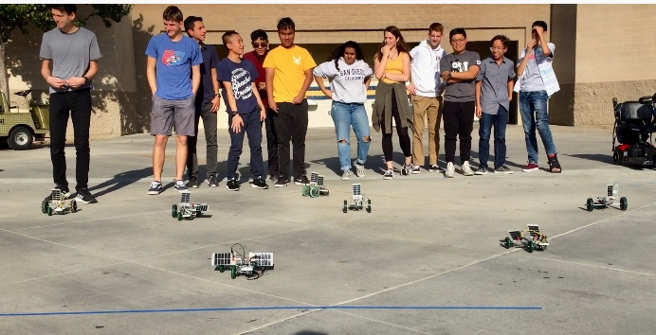
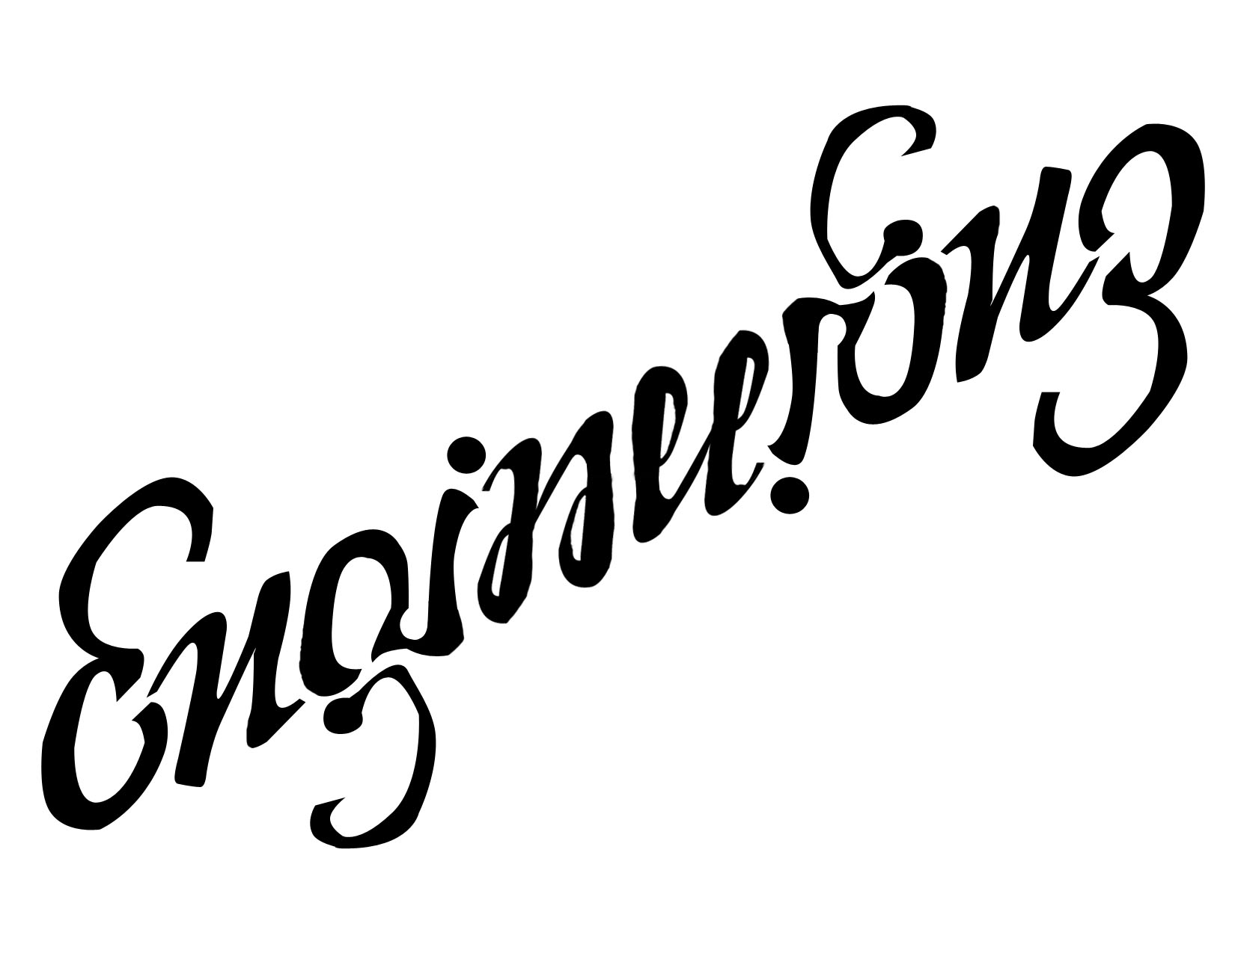

Slide 10

Why I am teaching this class
I envision ENGINEERING as a career choice for my students
I believe in INSPIRING INNOVATION in my students
I do equip my students with TECHNICAL KNOWLEDGE AND SKILLS
Notes:
I believe in inspiring innovation in students by providing the technical skills that students need to thrive in the emerging industry jobs of the 21st century.
I initiated this engineering program at VMHS so that the students will earn their own certification and adaptability to the industry demands in the field of engineering.
I envision that this engineering program will inspire more students to apply knowledge through their own creativity and technical innovation.

Slide 11
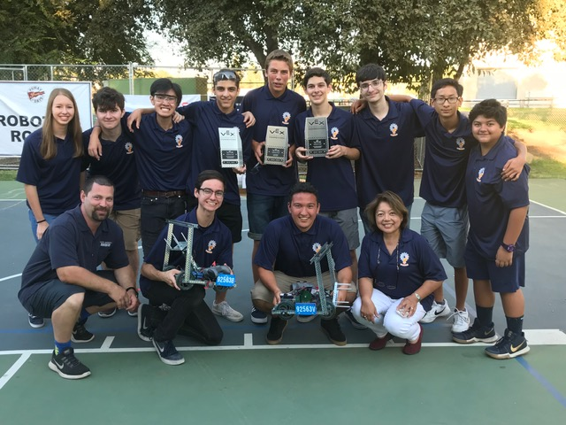
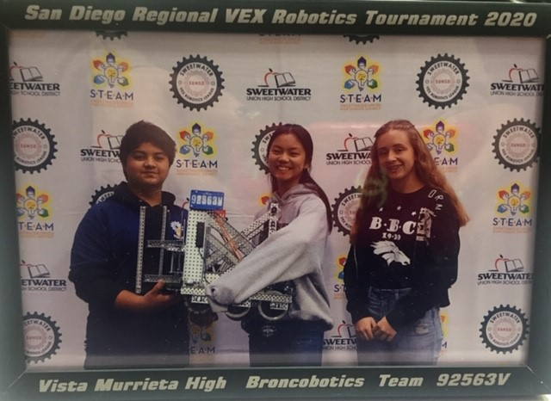
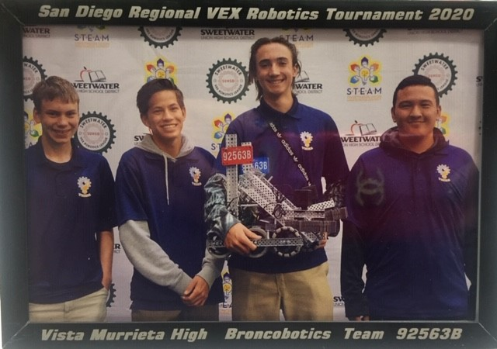
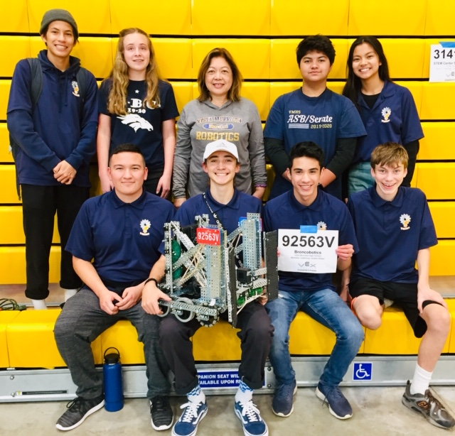
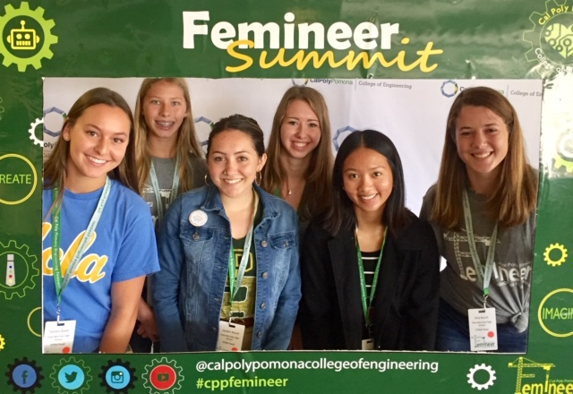
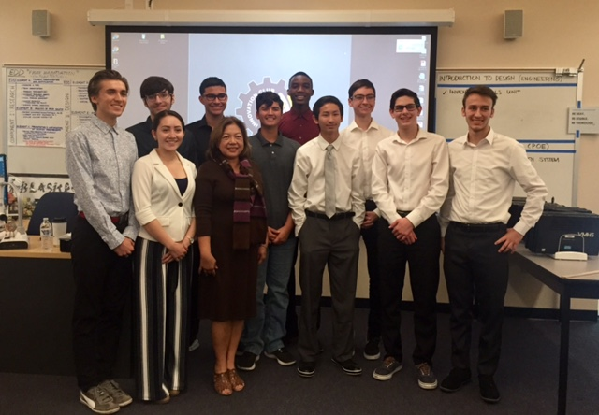

Slide 12
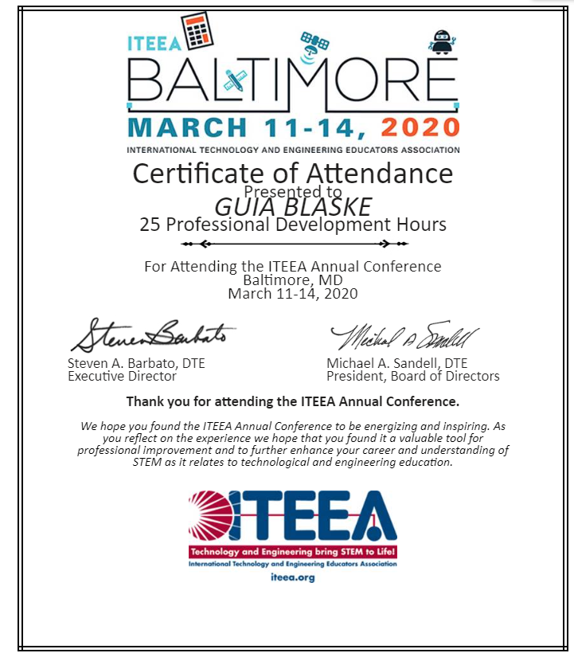

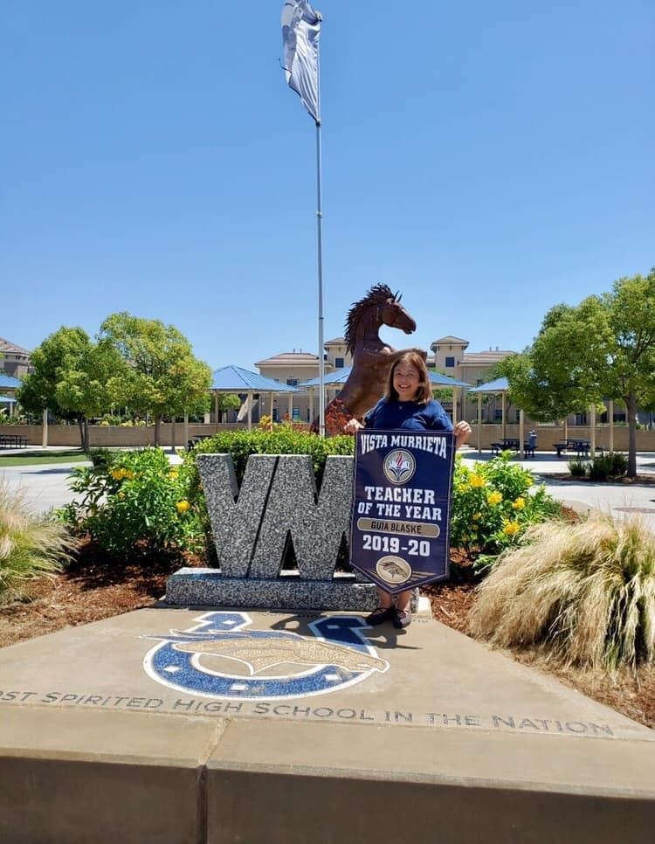
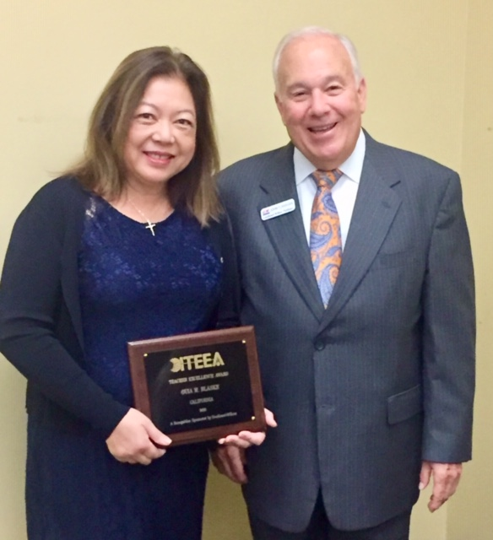
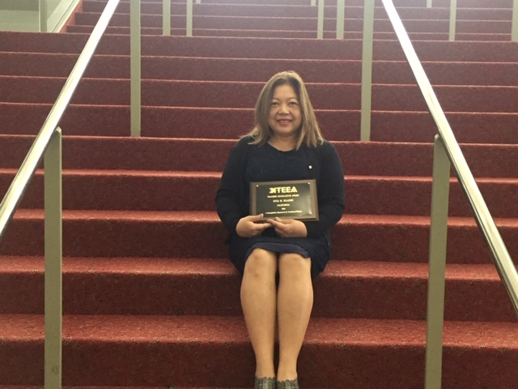

Slide 13
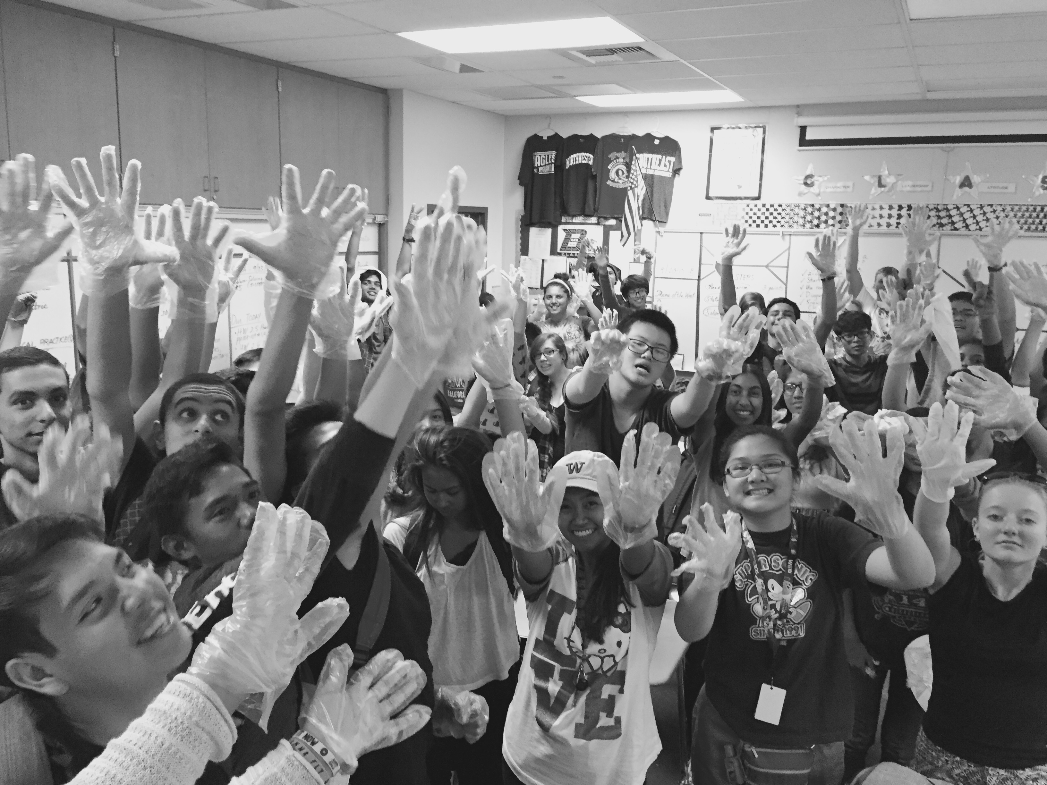
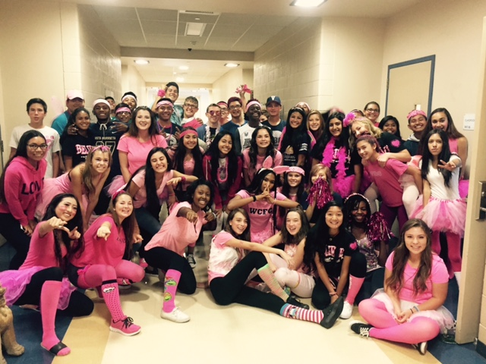
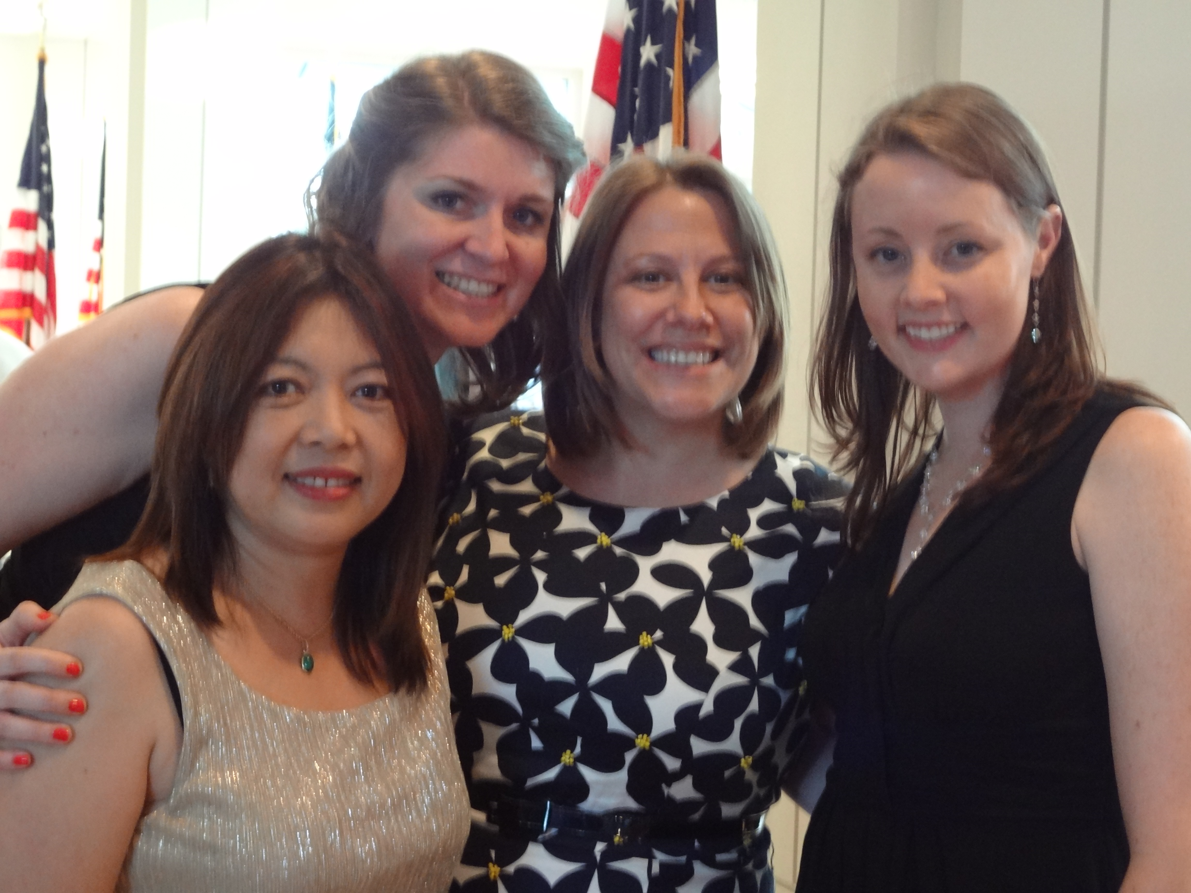
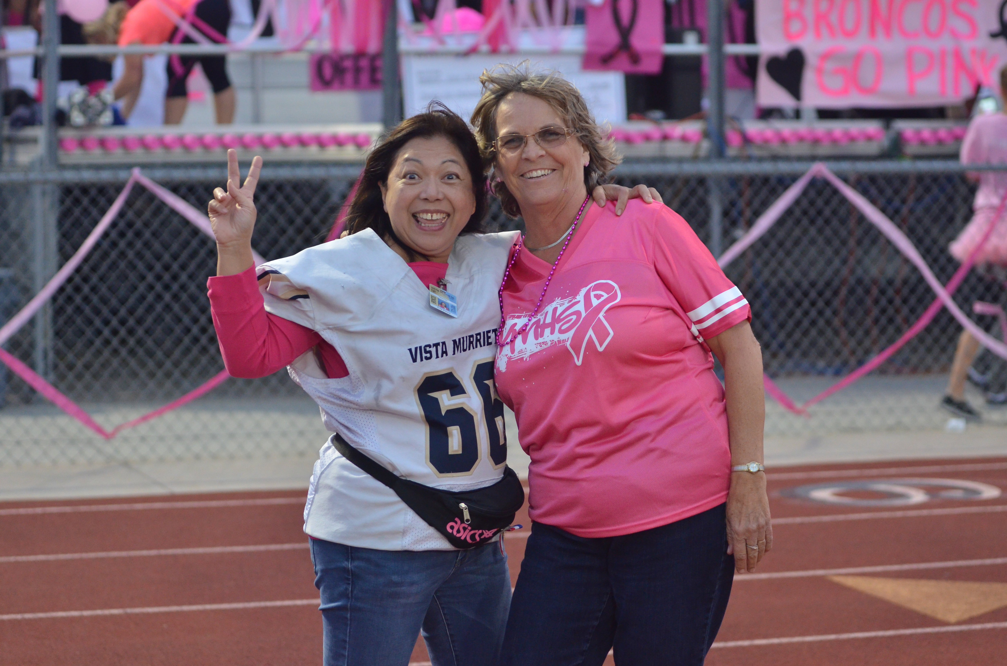
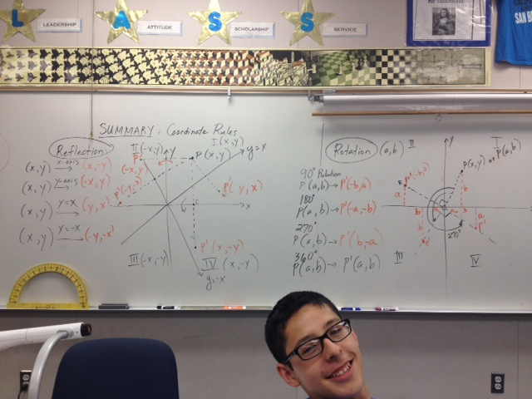
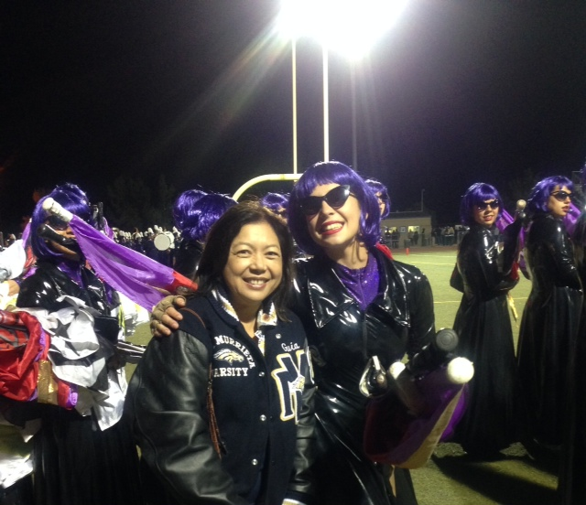
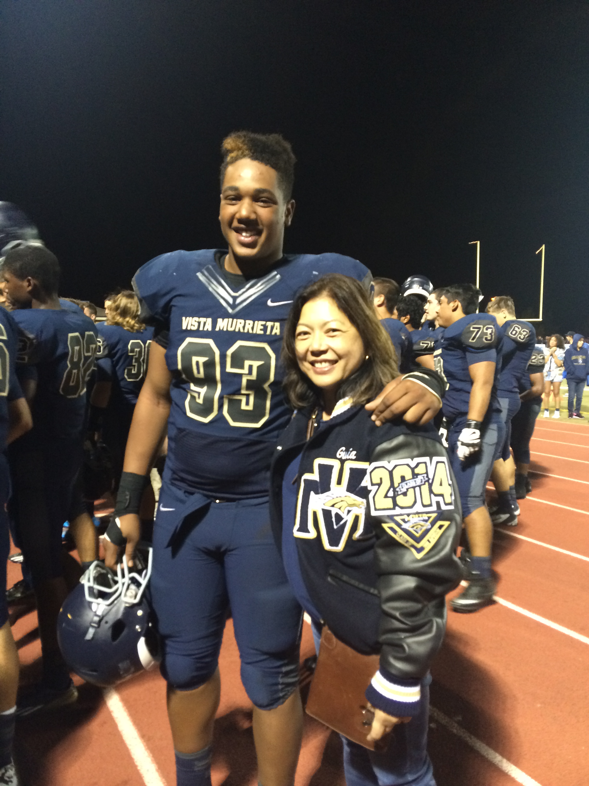
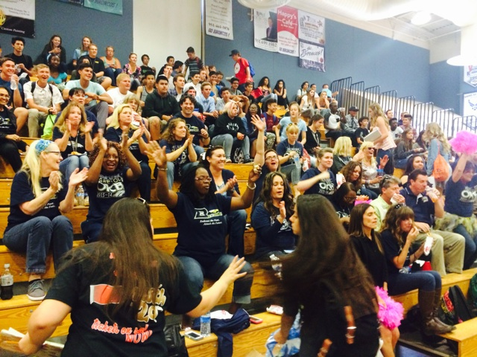
The Bronco Spirit: Once a Bronco, Always a Bronco!

Slide 14
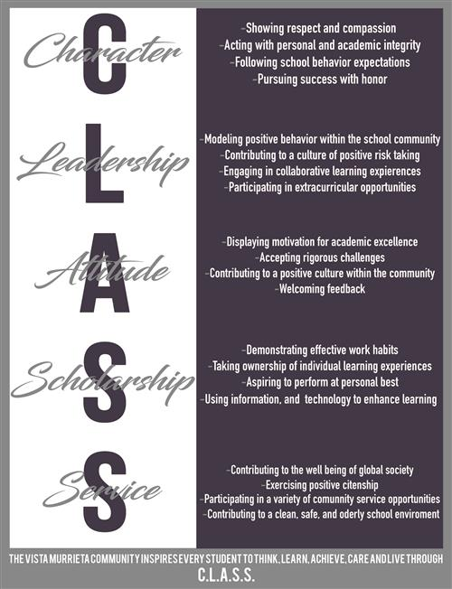
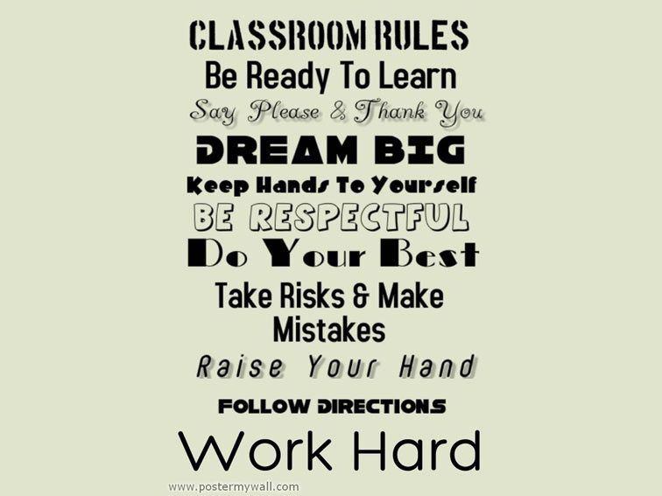
"The secret of education lies in respecting the pupil." by ralph waldo emerson
Mrs. Guia M. Blaske
VISTA MURRIETA HIGH SCHOOL
School year 2022-2023
Engineering Teacher
Lead Teacher/Chairperson, VMHS-CTE/ICT Department
Club Advisor, Interact/Innovation/SWE/Fil-Am clubs
Site Coordinator, PLTW VMHS CTE-Engineering
C-Building (Room C13/C14)
(951)894-5750 ext. 6628
Email: gblaske@murrieta.k12.ca.us
School website: https://www.murrieta.k12.ca.us/Domain/1744

Slide 15
Canvas Page
Career technical education (CTE)-Engineering Pathway
Course1: Intro to Design (ENGINEERING) Overview
      Canvas Weekly Plans
      Units of Study: Modules and Links; General Student Resources
      Foundational course; VPA/F Credit
Course 2: Principles of Engineering Overview
      Canvas Weekly Plans
      Units of Study: Modules and Links; General Student Resources
      Foundational/Concentrator Course: D Credit
Course 3: Digital Electronics (Specialization course taught by Mr. Larkins)
      Capstone Class: D Credit
Course 4: Engineering Design and Development Overview
      Capstone Class: D Credit : College Prep course
      Project Management; Timeline=10 months; Project Teams; Shop and Tool Management
      Project Lead The Way Website Access for all components of the project
      Teacher as Facilitator; Final Documentation and Presentation with a Panel of Professional Engineers/Professors

